Slide 1
GUI Programming in Python
Unit 1

Slide 2
What is GUI?
A graphical user interface is an application that has buttons, windows, and lots of other widgets that the user can use to interact with your application.
Advantages of GUI:-
It requires just a click on the simple picture or image in order to use its functionalities.
It is very easy to use by novice as it is user friendly.
Simple icon in GUI interface uses multiple instructions in the back end. Hence it is easy for the programmer to code in GUI languages compare to other non GUI based programming languages.

Slide 3
Introduction to GUI library
Python provides various options for developing graphical user interfaces (GUIs). Most important are listed below.
Tkinter- Python has a lot of GUI frameworks, but Tkinter is the only framework that’s built into the Python standard library. Tkinter has several strengths. It’s cross-platform, so the same code works on Windows, macOS, and Linux.
Tkinter is lightweight and relatively painless to use compared to other frameworks. This makes it a compelling choice for building GUI applications in Python, especially for applications where a modern sheen is unnecessary, and the top priority is to build something that’s functional and cross-platform quickly.

Slide 4
wxPython – It is a cross-platform GUI toolkit for the Python programming language. It allows Python programmers to create programs with a robust, highly functional graphical user interface, simply and easily. It is implemented as a set of Python extension modules. wxPython is Open Source, which means that it is free for anyone to use.

Slide 5
Advantages of tkinter
part of python, nothing extra to download. Very simple syntax.
For most GUIs, functionality is more important than form (ie: eye candy is not top priority). Even then, it's possible to make very nice looking GUIs with Tkinter.

Slide 6
Tkinter programming(library)
Tkinter is the standard GUI library for Python. Python when combined with Tkinter provides a fast and easy way to create GUI applications. Tkinter provides a powerful object-oriented interface to the Tk GUI toolkit.
Creating a GUI application using Tkinter is an easy task. All you need to do is perform the following steps −
Import the Tkinter module.
Create the GUI application main window.
Add one or more of the above-mentioned widgets to the GUI application.
Enter the main event loop to take action against each event triggered by the user.

Slide 7
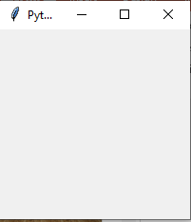
example
import tkinter as tk # 1
win = tk.Tk() # 2
win.title("Python GUI") # 3
win.mainloop() # 4

Slide 8
We are preventing the GUI from being resized.
import tkinter as tk # 1 imports
win = tk.Tk() # 2 Create instance
win.title("Python GUI") # 3 Add a title
win.resizable(0, 0) # 4 Disable resizing the GUI
win.mainloop() # 5 Start GUI
Why is this important? Because, once we add widgets to our form, resizing can make our GUI look not as good as we want it to be.

Slide 9
Geometry management
The Tkinter geometry specifies the method by using which, the widgets are represented on display. The python Tkinter provides the following geometry methods.
The pack() method
The grid() method
The place() method

Slide 10
pack():- It organizes the widgets in the block, which mean it occupies the entire available width. It's a standard method to show the widgets in the window.
widget.pack(options)
grid():- It organizes the widgets in table-like structure. We can specify the rows and columns as the options in the method call.
widget.grid(options)
place():- It's used to place the widgets at a specific position you want.
widget.place(options)

Slide 11
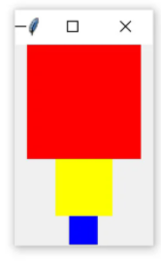
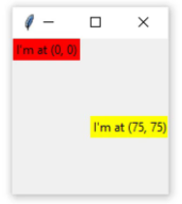
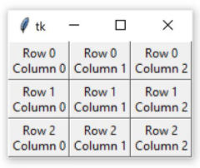
pack
place
grid

Slide 12
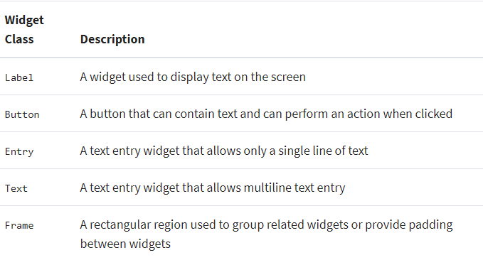
Tkinter widgets

Slide 13
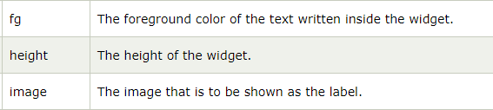
Displaying Text and Images With Label Widgets
Label widgets are used to display text or images. The text displayed by a Label widget can’t be edited by the user. It’s for display purposes only.
w = Label (master, options)
A list of possible options is given below.

Slide 14
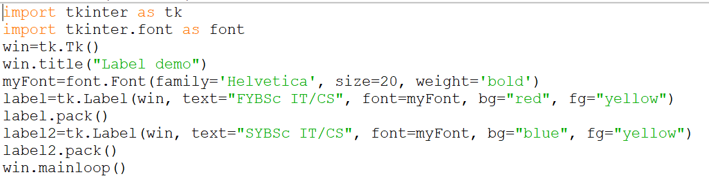
LABEL WITH TEXT

Slide 15
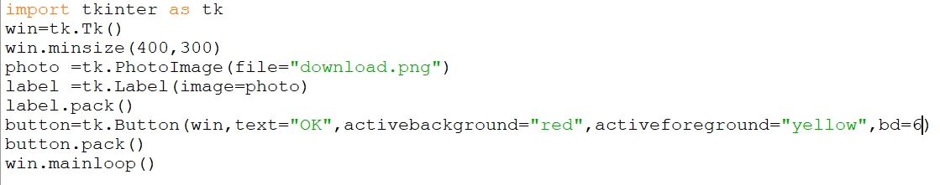
LABEL WITH IMAGE

Slide 16
Displaying Clickable Buttons With Button Widgets
Button widgets are used to display clickable buttons. They can be configured to call a function whenever they’re clicked.
There are many similarities between Button and Label widgets. In many ways, a Button is just a Label that you can click! The same keyword arguments you use to create and style a Label will work with Button widgets.
Syntax
Here is the simple syntax to create this widget −
w = Button ( master, option=value, ... )
Parameters
master: This represents the parent window.
options: list of most commonly used options for this widget. These options can be used as key-value pairs separated by commas.

Slide 17
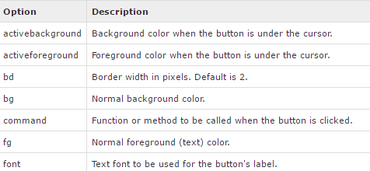


Slide 18
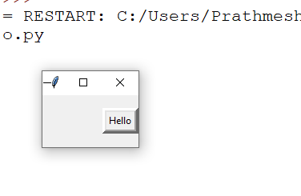
import tkinter as tk
top = tk.Tk()
B = tk.Button(top, text ="Hello", activebackground="red",activeforeground="blue",bd=5)
B.pack( side="right" )
top.mainloop()

Slide 19
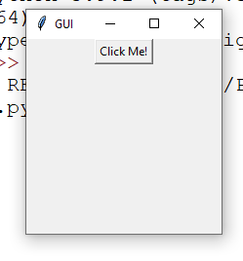
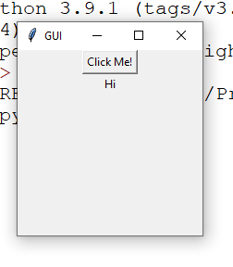
In the below example, when you click the button, it calls a function called say_hi.
Function say_hi creates a new label with the text Hi.
#example
import tkinter
window = tkinter.Tk()
window.title("GUI")
# creating a function called say_hi()
def say_hi():
tkinter.Label(window, text = "Hi").pack()
tkinter.Button(window, text = "Click Me!", command = say_hi).pack() # 'command' is executed when you click the button
# in this above case we're calling the function 'say_hi'.
window.mainloop()

Slide 20
Getting User Input With Entry Widgets
When you need to get a little bit of text from a user, like a name or an email address, use an Entry widget. They display a small text box that the user can type some text into. Creating and styling an Entry widget works pretty much exactly like Label and Button widgets.
Syntax
w = Entry( master, option, ... )
Parameters:
master: This represents the parent window.
options: Here is the list of most commonly used options for this widget. These options can be used as key-value pairs separated by commas.

Slide 21
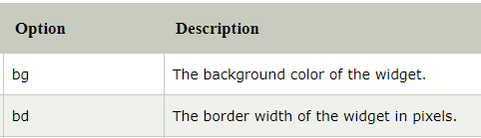

There are three main operations that you can perform with Entry widgets:
1. Retrieving text with .get()
2. Deleting text with .delete()
3. Inserting text with .insert()

Slide 22
Import tkinter as tk
top = tk.Tk()
L1 = tk.Label(top, text="User Name")
L1.pack( side = LEFT)
E1 = tk.Entry(top, bd =5)
E1.pack(side = RIGHT)
top.mainloop()

Slide 23
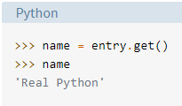
You can use .get() to retrieve the text and assign it to a variable called name:

Slide 24
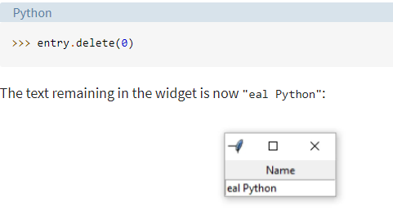
You can .delete() text as well. This method takes an integer argument that tells Python which character to remove. For example, the code block below shows how .delete(0) deletes the first character from the Entry:

Slide 25
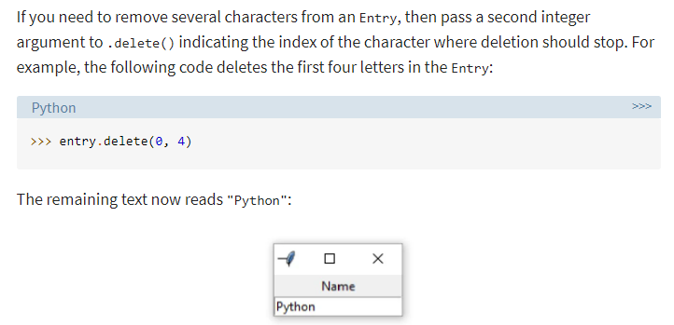

Slide 26
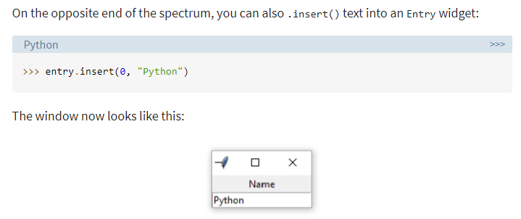
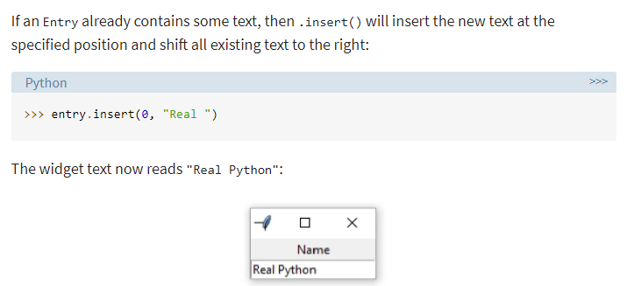

Slide 27
Events and bindings
As was mentioned earlier, a Tkinter application spends most of its time inside an event loop (entered via the mainloop method). Events can come from various sources, including key presses and mouse operations by the user, and redraw events from the window manager (indirectly caused by the user, in many cases).
Tkinter provides a powerful mechanism to let you deal with events yourself. For each widget, you can bind Python functions and methods to events.
widget.bind(event, handler)If an event matching the event description occurs in the widget, the given handler is called with an object describing the event.
Where,
event can be button clicked or key press etc
handler can be type of button or key used to handle event
Whenever event occurs the handler is called to execute particular function related to the event.

Slide 28
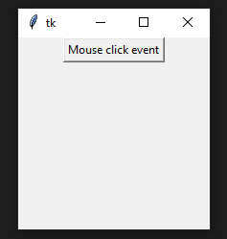

Program to implement button event with bind method
from tkinter import *
import sys
root=Tk()
def singleclk(event):
print("Button-1 single click")
def doubleclk(event):
print("Button double click exit")
sys.exit()
btn=Button(root,text="Mouse click event")
btn.pack()
btn.bind('<Button-1>',singleclk)
btn.bind('<Double-1>',doubleclk)
root.mainloop()

Slide 29
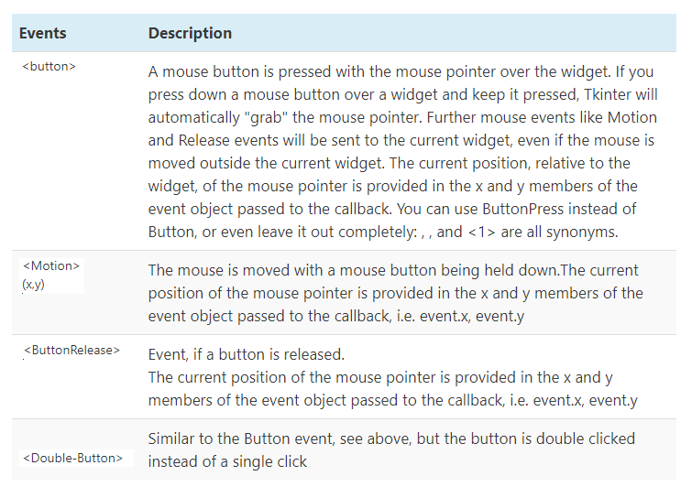

Slide 30
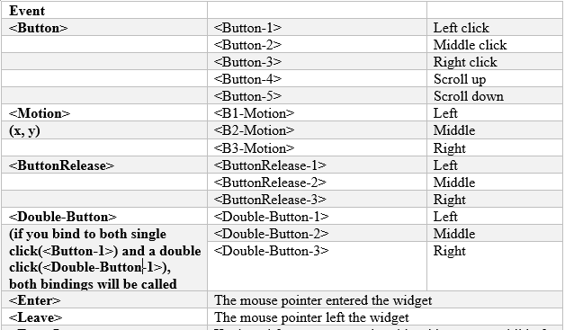

Slide 31
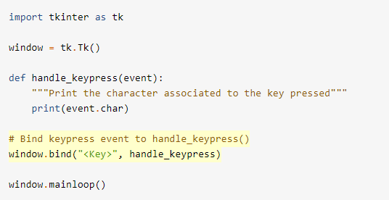
Key event

Slide 32
Frame widget
The Frame widget is very important for the process of grouping and organizing other widgets in a somehow friendly way.
It uses rectangular areas in the screen to organize the layout and to provide padding of these widgets. A frame can also be used as a foundation class to implement complex widgets.
Syntax
w = Frame ( master, option, ... )
Parameters
master: This represents the parent window.
options: Here is the list of most commonly used options for this widget. These options can be used as key-value pairs separated by commas.

Slide 33
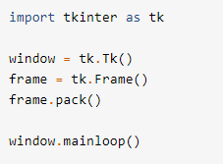

frame.pack() packs the frame into the window so that the window sizes itself as small as possible to encompass the frame.

Slide 34
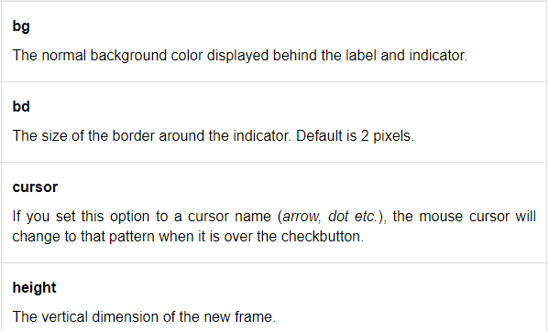
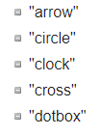

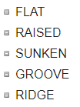

Slide 35
MESSAGE WIDGET
This widget provides a multiline and noneditable object that displays texts, automatically breaking lines and justifying their contents.
Its functionality is very similar to the one provided by the Label widget, except that it can also automatically wrap the text, maintaining a given width or aspect ratio.
Syntax
Here is the simple syntax to create this widget −
w = Message ( master, option, ... )Parameters
master: This represents the parent window.
options: Here is the list of most commonly used options for this widget. These options can be used as key-value pairs separated by commas.

Slide 36
from tkinter import *
root = Tk()
root.minsize(300,200)
lbl = Label(root, text =‘FYBScCS', font = (“Arial”,”50”))
lbl.pack()
msg = Message( root, text = “Students of CS")
msg.pack()
root.mainloop()

Slide 37

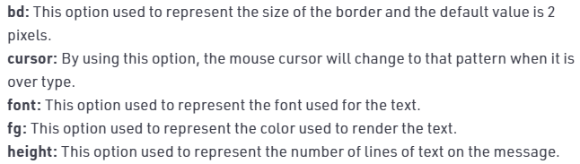

Slide 38
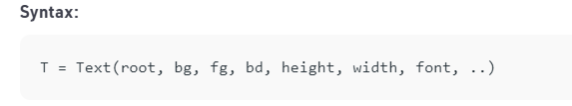
Text widget
Text Widget is used where a user wants to insert multiline text fields.
This widget can be used for a variety of applications where the multiline text is required such as messaging, sending information or displaying information and many other tasks.

Slide 39
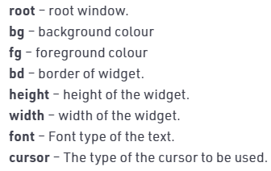
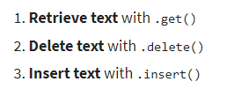
Optional Parameters

Slide 40
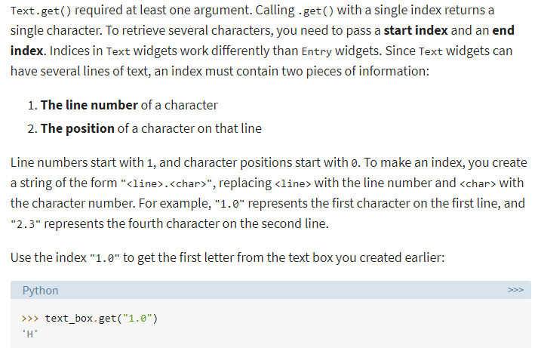

Slide 41
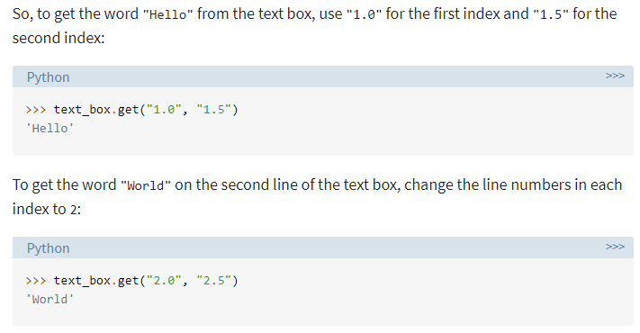

Slide 42
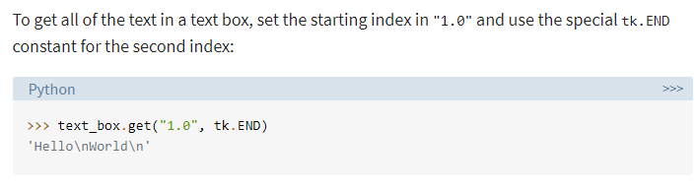
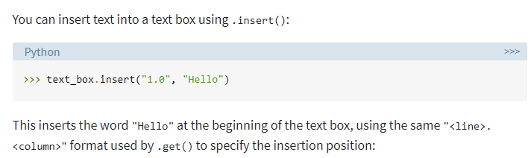

Slide 43
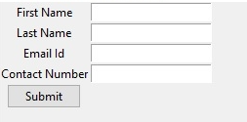
Example

